Slide 1

NTLM and Kerberos
Authentication Fundamentals, Vulnerabilities and Mitigations

Slide 2
Topics
LM and NTLM Authentication
Kerberos
Kerberos Delegation

Slide 3

LM and NTLM
Password hashes
Challenge / Response authentication

Slide 4
The Password Hash
Storing passwords in clear-text and sending passwords in clear over the network.
  Vulnerable to password theft at every authentication attempt.
Protecting Passwords at rest
  Passwords subjected through a one-way hashing function (OWF)
  Resulting hash or secret is stored in active directory for domain accounts or SAM database for local accounts
Protecting passwords during authentication with a server.
  During authentication, Server sends a challenge.
  Client uses hash to encrypt data and transmit encrypted data as response.
  Password or password hash never transmitted.

Slide 5
LM Hash vs NT Hash
User’s password: Password1
LMHash (LM OWF)
NTHash (NT OWF)
P a s s w o r d 1
P a s s w o r d 1
PASSWOR + D1
md4
DES
DES
E52CAC67419A9A22 + 38F10713B629B565
64F12CDDAA88057E06A81B54E73B949B
E52CAC67419A9A2238F10713B629B565
Disabled by default since 2008

Slide 6
LM Hashes are Weak
ASCII character set.
Password changed to uppercase.
Null-padding to 14 bytes; easy to guess if password it is a 7-character password.
The "fixed-length" 14-byte password is split into two 7-byte halves
Each 7-byte half is used with the DES function to create two 8-byte cipher-text values
No salt is used in the creation of the hash

Slide 7
Prevent Generation of LM Hashes
Group policy setting: Network security: Do not store LAN Manager hash value on next password change.
Registry value: NoLMHash

Slide 8





NTLM Challenge / Response
Pwd_Hash in LSASS
NTLM_Challenge
Dir \\10.10.10.55\Share01
NTLM_Response
NTLM_Negotiate
Username +
NTLM_Challenge +
NTLM_Response (C)
NTLM_Challenge
Pwd_Hash
NTLM_Response (DC) = NTLM_Response (C)
NTLM_Challenge
NTLM_Response
Pwd_Hash
NTLM_Response (DC) != NTLM_Response (C)
NTLM_Response (DC)
Pwd_Hash in NTDS.dit

Slide 9
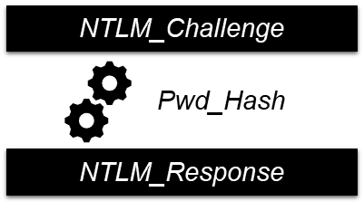
NTLM v1 vs NTLM v2
Difference is in encryption during response generation
NTLM v1 uses weaker DES-ECB
NTLM v2 uses stronger HMAC-MD5

Slide 10
Prevent use of Weak Responses
Group Policy: Network Security: LAN Manager authentication level
Registry: LmCompatibilityLevel

Slide 11
Prevent use of Weak Responses
Device Type | Level | Sends | Accepts | Prohibits Sending
Client | 0 | LM, NTLM | LM, NTLM, NTLMv2 | NTLMv2, Session security
 | 1 | LM, NTLM, Session security | LM, NTLM, NTLMv2 | NTLMv2
 | 2 | NTLM, Session security | LM, NTLM, NTLMv2 | LM and NTLMv2
 | 3 | NTLMv2, Session security | LM, NTLM, NTLMv2 | LM and NTLM
Server | 4 | NTLMv2, Session security | NTLM, NTLMv2 | LM
 | 5 | NTLMv2, Session security | NTLMv2 | LM and NTLM

Slide 12
Password Storage in Active Directory
Active Directory Attribute | Content
unicodePwd | Encrypted NT Hash
dbcsPwd | Encrypted LM Hash
ntPwdHistory | Encrypted NT Hashes - Password History
lmPwdHistory | Encrypted LM Hashes - Password History
supplementalCredentials | Kerberos Keys, WDigest, etc.

Slide 13
Kerberos
Kerberos Key Exchanges
Vulnerabilities and Mitigations

Slide 14
Shortfalls of NTLM
No mutual authentication
  Server does not have to authenticate to client => clients are susceptible to rogue servers
Password hashes used for NTLM are not salted => identical passwords result in identical hashes.
Every authentication exchange exposes the password hash => security depends on strength of password.
NTLM is proprietary to Microsoft
No support for delegation (acting on behalf of)
No support for MFA.

Slide 15
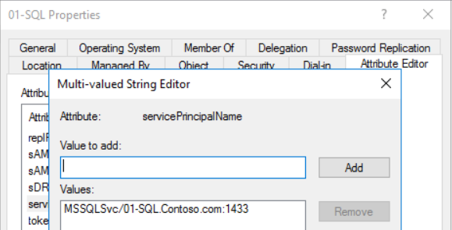
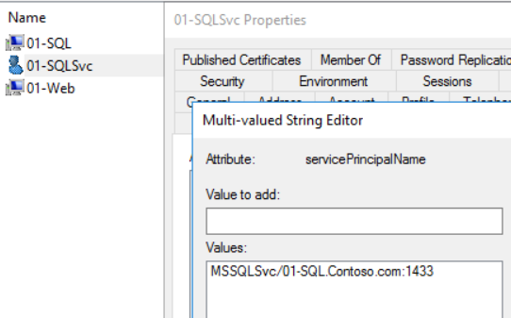
Kerberos Entities
Kerberos Key Distribution Center (Litware.com)
UserPrincipalName:
Alex@Litware.com
ServicePrincipalName: CIFS/FileSvr01.Litware.com

Slide 16
Kerberos Exchanges
Authentication Service (AS) exchange
  Client <-> KDC
  Authentication of client to KDC
Ticket-Granting Service (TGS) exchange
  Client <-> KDC
  Service ticket from KDC for access to server
Authentication Protocol (AP) exchange
  Client <-> Server
  Authentication to server using service ticket

Slide 17
Authentication Service (AS) exchange
(TGT) encrypted with krbtgt pwd hash
When: Initial user logon; when lifetime of ticket expires
TGT can only be decrypted by DCs
TGT contains Session key-c
Session key-c will be used for all further exchanges
UserPrincipalName
(Timestamp) encrypted with user pwd hash
Aka Pre-authentication data
(Session key-c) encrypted with user pwd hash
UPN is valid and unique
Timestamp can be decrypted
Timestamp is within allowed skew

Slide 18

Kerberoasting (var. AS-REP Roasting)
(Session key-c) encrypted with user pwd hash can be subject to brute-force attack
  Successful cracking reveals user pwd
Attack mitigated by requiring pre-authentication data
  Requestor must prove knowledge of password
User account configured to “Do not require Kerberos preauthentication”
  Attacker can make AS request without pre-authentication data
  No proof of password knowledge provided.

Slide 19
Ticket-Granting Service (TGS) exchange
(Service ticket) encrypted with srv/svc account pwd hash
When: Client needs to connect to service (server)
Service Ticket can only be decrypted by Server
Session key-c used for exchanges between client and DC
Session key-s will be used for all exchanges between client and server
SPN of service
(TGT) encrypted with krbtgt pwd hash
(UPN + timestamp) encrypted with Session key-c
(Session key-s) encrypted with Session key-c
SPN is valid and unique
UPN + Tmstmp can be decrypted
Timestamp is within allowed skew
TGT is decrypted (DC has krbtgt pwd hash)
TGT contains Session key-c

Slide 20


Kerberoasting (var. TGS-REP Roasting)
(Service ticket) encrypted with server/svc account pwd hash can be subject to brute-force attack
  Successful cracking reveals server/svc account pwd
Service accounts configured with “Password never expires”
  Indefinite time to brute-force
Svc account passwords just meets domain pwd policy
  Easier to crack 8-character password than 25-character password
Svc accounts configured with “Use only Kerberos DES encryption types for this account”
  Encryption uses DES algorithm instead of default RC4 for user accounts and AES for machine accounts
  Orders of magnitude easier to bruteforce

Slide 21

Kerberoasting Mitigations
Set passwords of 25 characters or more for service accounts
Periodically reset service account passwords
Set service accounts to use AES
Use Group Managed Service Accounts when possible

Slide 22
Authentication Protocol (AP) exchange
(Service ticket) encrypted with srv/svc account pwd hash
When: Client needs to connect to service (server)
Service Ticket can only be decrypted by Server
Both client and server has Session key-s
Session key-s will be used for all exchanges between client and server
(UPN + timestamp) encrypted with Session key-s
(UPN + timestamp) encrypted with Session key-s
UPN + Tmstmp can be decrypted
(client has Session Key-s)
Mutual authentication
Service ticket is decrypted (own pwd hash)
Service ticket contains Session key-s
UPN + Tmstmp can be decrypted
Timestamp is within allowed skew

Slide 23
Kerberos and Password Hashes
Kerberos uses password hashes/secrets.
Algorithm and salting depends on encryption type specified.
  DES - MD5 hash salted with user logon name
  RC4 - MD4 hash
  AES-128 / AES-256 - HMAC-SHA1 salted with user logon name
AES based encryption is available only once the DFL is raised to 2008 or higher
  Secrets must be changed after the DFL upgrade before using AES
Group policy: Network security: Configure encryption types allowed for Kerberos
AD property: msDS-SupportedEncryptionTypes

Slide 24
Kerberos Delegation
Delegation types
Vulnerabilities and Mitigations

Slide 25
The Need for Kerberos Delegation
Three entities:
  User
  Front-end service (IIS web service) or service account (worker process)
  Back-end service (SQL server instance) or service account (svc account)
Allows access to back-end resources based on the user connecting to front-end service.
Examples:
  Administrator connecting to web server able to view all tables in a SQL database
  Regular user only able to view a subset of tables.

Slide 26
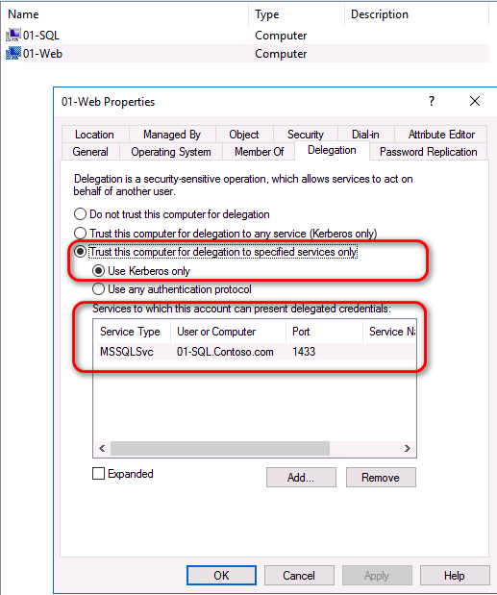
Kerberos Delegation
Service ticket for SQL on behalf of client

Slide 27
Delegation Types
Unconstrained Delegation
  Windows 2000+
Constrained Delegation
  Windows Server 2003+
Resource-based constrained delegation
  Windows Server 2012+

Slide 28
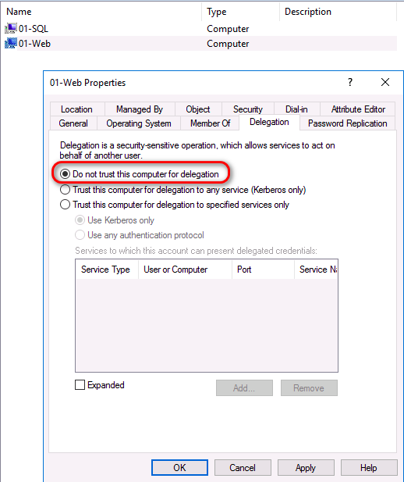
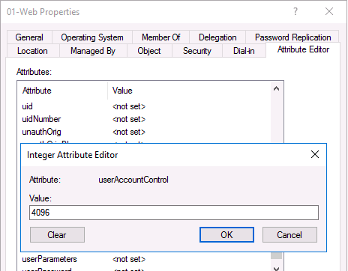
No Delegation

Slide 29
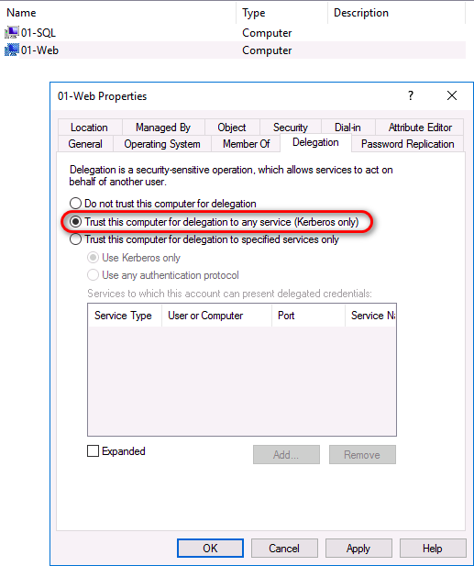
Unconstrained Delegation
Delegation without bounds - front-end server can impersonate any user to any back-end service
userAccountControl: 528384

Slide 30
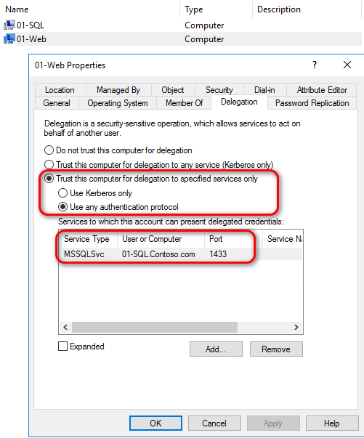
Constrained Delegation w/ Protocol Transition
Aka Services For User to Self (S4U2S)
Provides the ability for a service running on a server to get a Kerberos ticket for an end client, even if the end client did not authenticate using Kerberos.
userAccountControl: 16781312

Slide 31
Constrained Delegation
Aka Services for User to Proxy (S4U2P)
Limited delegation starting Windows Server 2003
Domain Admins control which back-end services a front-end service can impersonate to.
userAccountControl: 4096

Slide 32
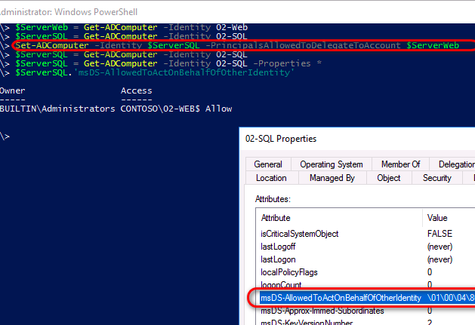
Resource-based constrained delegation
Delegation available beginning Windows Server 2012
Back-end service administrators control which front-end services can impersonate to it.
Cross-domain delegation now supported

Slide 33
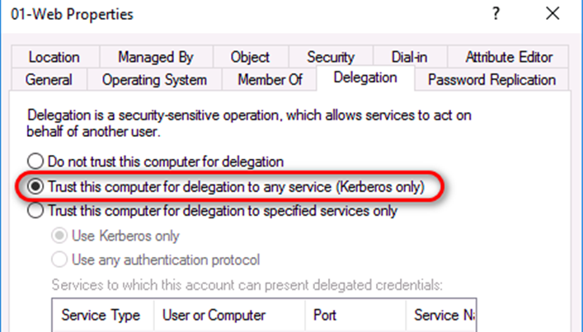

Dangers of Unconstrained Delegation
Service ticket for SQL on behalf of “admin”
Service ticket for DC on behalf of “admin”
Service ticket for FILE on behalf of “admin”
Service ticket for EXCH on behalf of “admin”

Slide 34

Prevent Delegation of Privileged Accounts
Enable Account is sensitive and cannot be delegated for high privileged accounts
Or add as members of Protected Users security group.

Slide 35
UserAccountControl Flags to Monitor
Description | UserAccountControl Value | Property Flag | Risk
Unconstrained Delegation | 524288 | TRUSTED_FOR_DELEGATION | High
Constrained Delegation (S4U2S) | 16777216 | TRUSTED_TO_AUTH_FOR_DELEGATION | Low
Password Never Expires | 65536 | DONT_EXPIRE_PASSWORD | High
Store Pwd Using Reversible Encryption | 128 | ENCRYPTED_TEXT_PWD_ALLOWED | High
Account is Sensitive and Cannot Be Delegated | 1048576 | NOT_DELEGATED | Low
Use Only Kerberos DES Encryption Types for This Account | 2097152 | USE_DES_KEY_ONLY | High
Do Not Require Kerberos PreAuthentication | 4194304 | DONT_REQ_PREAUTH | High
Service Accounts AT RISK! |  | DONT_EXPIRE_PASSWORD + DONT_REQ_PREAUTH | High

Slide 36
Strength of Kerberos
Client authenticates server
Depending on e-type used hashes are salted
After Authentication Sequence, session keys are used instead of passwords
Kerberos is an open standard
Kerberos supports various types of delegation
Support for smart cards

Slide 37

Thank You!

